Slide 1

College Event Feedback System

Slide 2
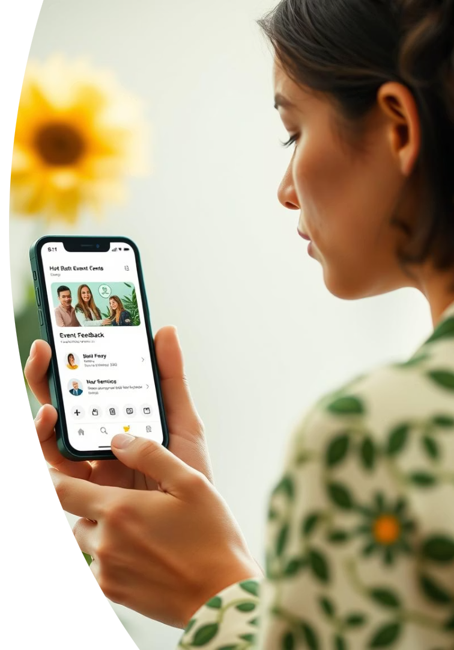
Table of Contents
1. Introduction
2. Existing Problem
3. Project Overview
4. Key Objective
5. Student Dashboard
6.Student Features
7. Administrator Features
8.Feedback History

Slide 3

College Event Feedback System
A web application designed to gather insightful feedback from students on college events.
It provides intuitive dashboards for both students and administrators, real-time sentiment analysis, and structured feedback management

Slide 4
Existing Problems:-
Manual feedback collection is time-consuming
Low participation due to lengthy forms
Difficulty in analyzing responses
Lack of real-time insights

Slide 5
Project Overview
Purpose
User Roles
Technology Stack
Web application for student feedback on college events.
Separate interfaces for Students and Administrators.
Built with React, TypeScript, and TailwindCSS for modern design.

Slide 6




Key Objectives
Structured Feedback
Improve Event Quality
Enable students to provide organized input.
Support administration with data-driven insights.
Visualize Trends
Show sentiment and participation over time.

Slide 7






Student Dashboard
Completed Events
List of events ready for feedback.
Personal Welcome
Custom greeting with student's name.
Recent Feedback
Quick view of latest sentiment tags.

Slide 8
Student Features
Submit Feedback
Quickly rate and comment on events.
Upcoming Events
Browse and plan for future activities.
Feedback History
Review all past submissions.
Sentiment Insights
Understand personal feedback impact.

Slide 9



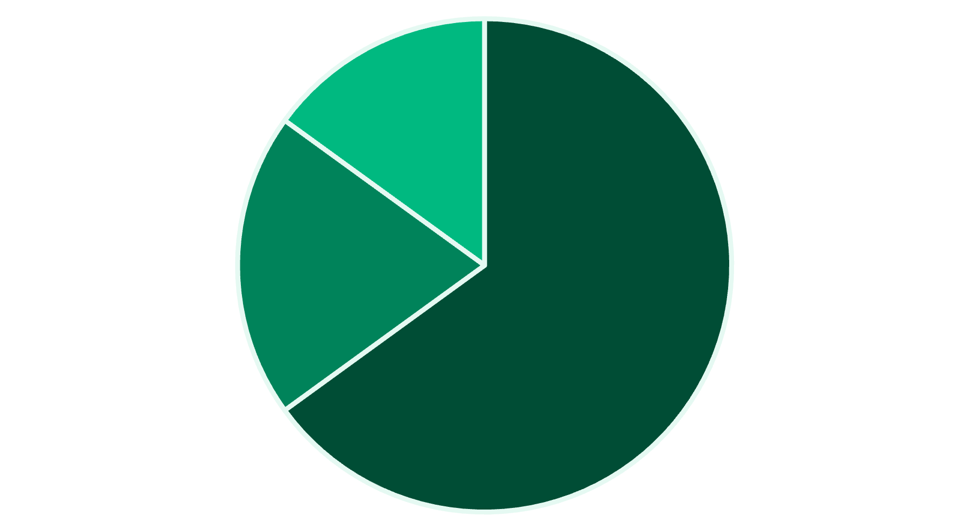

Administrator Features
Manage Events
Access Feedback
Oversee event data and details.
Comprehensive view of all student submissions.
Sentiment Analysis
Track trends and statistics on feedback.
Neutral
Positive
Negative

Slide 10
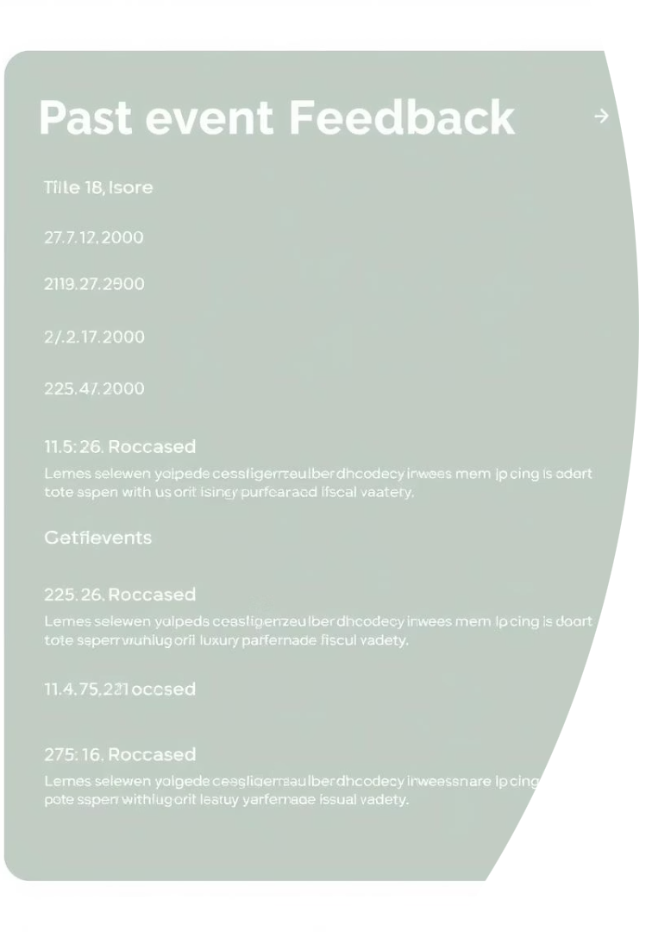
Feedback History
Chronological View
Feedback entries ordered by date.
Key Details
Ratings, comments, sentiment, and event info.
Searchable
Easily locate specific feedback entries.

Slide 11
Future Improvements
Backend integration with real API.
User authentication and JWT.
Admin dashboard enhancements.
Event management features.
Thank You!

